Slide 1




FYP-2020
IoT-Vision Enabled Assistant for Epileptic Patients
Supervisor: Mr. Samyan Qayyum Wahla
Department of Computer Science
University of Engineering & Technology, Lahore

Slide 2



TEAM PRESENTATION
Muhammad Ali Murtaza
2020-CS-114
Zeshan Ayub
2020-CS-113
Ali Tariq
2020-CS-142
Syed Azeem Ali Hashmi
2020-CS-156
2

Slide 3

Content Outline
Topics for discussion
01
Introduction
02
Literature Review
03
Architecture
04
Implemented Modules
05
Methodology
06
Project Demonstration
07
Conclusion

Slide 4



INTRODUCTION
BACKGROUND
50 Million People
Have epilepsy around the world
9.9 per 1000 People
Prevalence of epilepsy in Pakistan
Risk of Premature Death
3x more than general population
Notes:
https://www.ncbi.nlm.nih.gov/pmc/articles/PMC8794165/

Slide 5
PROBLEM STATEMENT
“
Develop a cost-efficient smart system to monitor daily life activities of elderly epileptic patients for detection, prevention and forecasting of seizures as well as provide useful insights to improve their living standard.
”
5

Slide 6
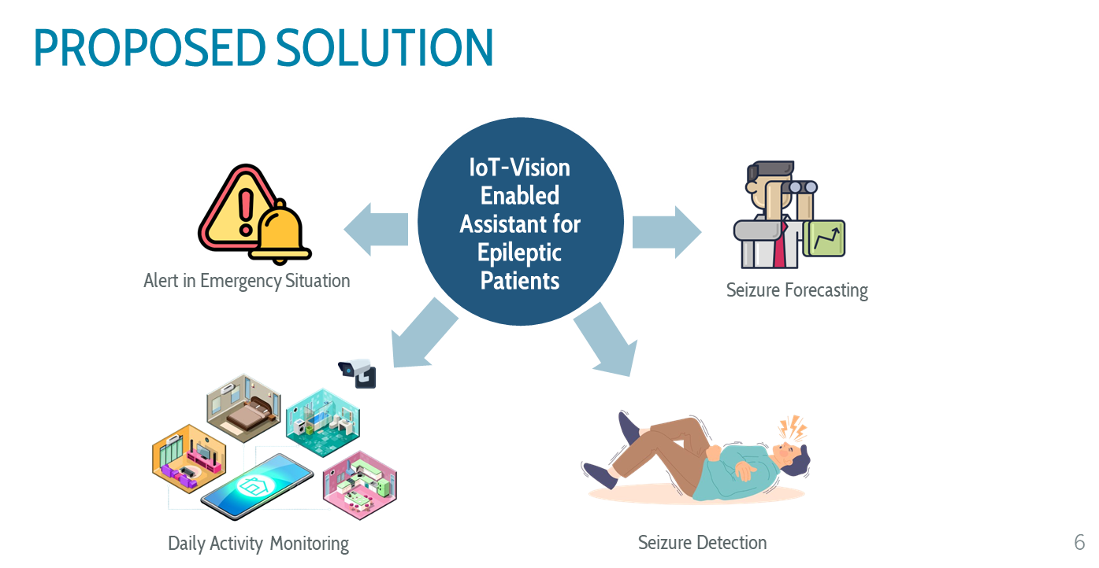
5

Slide 7
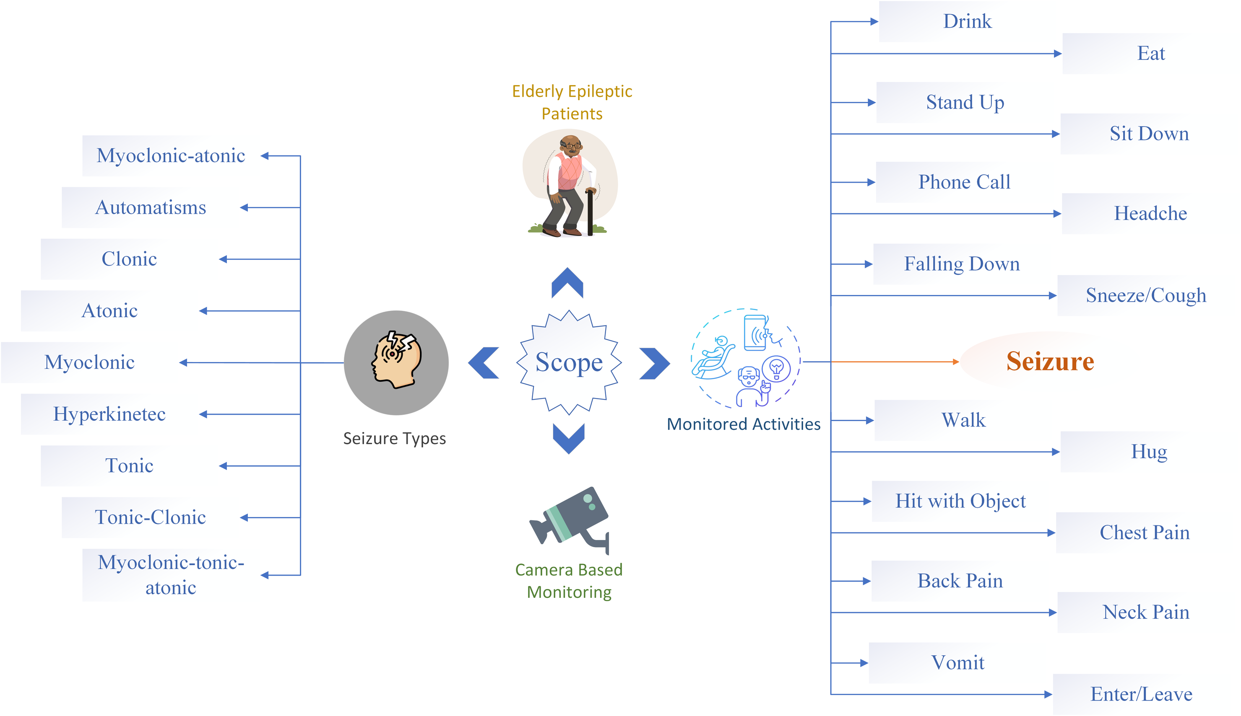
Scope
6

Slide 8


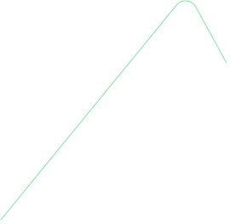
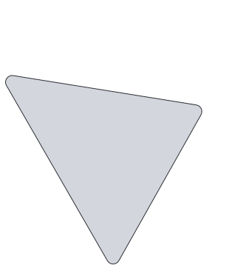
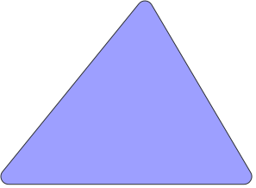



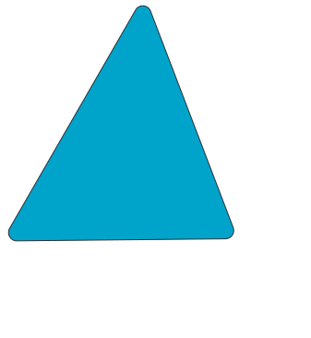
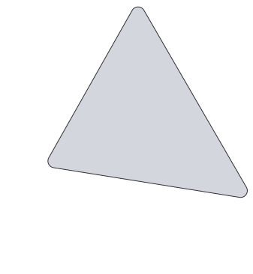

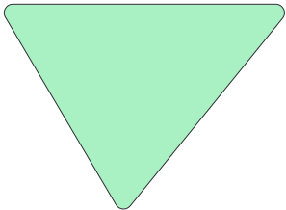

Motivation
Burden removal in the nursing sector
Exponential rise in epilepsy cases
Efficient and economical monitoring solution
Economic growth in healthcare
Independence of Old Age
Cost
Motivation
Burden Removal
Economical growth
7
Notes:
Constant monitoring of elderly epileptic patients burdens caretakers and intrudes upon patients' privacy.(burden removal on caretaker)
The exponential rise in elderly epilepsy underscores the demand for enhanced medical support and lifestyle adjustments.
Efficient and economical monitoring solutions are imperative to detect and forecast seizures, alle vialing strain on caregivers.
Implementing such solutions promises to relieve pressure on the nursing sector, preserve patient privacy, and stimulate economic growth in healthcare.

Slide 9
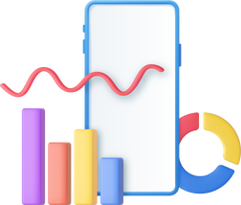

Literature Review
Title | Modality | Methodology | Category | Year | Phase of Seizure | Detection of Seizure | Forecasting of Seizure | Wearable Device
Automated class-based compression for real-time epileptic seizure detection | EEG Signal based | Classification and data reduction technique | Supervised | 2018 | Ictal
An ultra-low power smart headband for real-time epileptic seizure detection | EEG Signal based | Analogue front-end circuitry, epileptic seizure detection tag, Bluetooth low power chip | Supervised | 2018 | Ictal
Applying deep learning for epilepsy seizure detection and brain mapping visualization | Patient Video Recording | CNN and LSTM | Supervised | 2019 | Ictal
Aberrant epileptic seizure identification: A computer vision perspective | EEG Recordings | GAN | Unsupervised | 2019 | Preictal
Deep Learning Approaches for Automated Seizure Detection from Scalp Electroencephalograms | EEG Signal based | CNN/LSTM and Channel-based LSTM | Supervised | 2020 | Ictal

Slide 10
Literature Review
Title | Modality | Methodology | Category | Year | Phase of Seizure | Detection of Seizure | Forecasting of Seizure | Wearable Device
A hybrid densenet-LSTM model for epileptic seizure prediction | EEG Signal based | Densenet and LSTM. | Supervised (Interictal, preictal) | 2021 | Interictal and Preictal
EZcap: A Novel Wearable for Real-Time Automated Seizure Detection from EEG Signals | EEG Signal based | Kriging | Supervised | 2022 | Ictal
A real-time seizure classification system using computer vision techniques | 5 sec videos of seizure | FER (Facial Emotion Recognition) | Supervised | 2022 | Ictal
Generalized Epileptic Seizure Prediction using Machine Learning Method | EEG Signal based | K-Means Clustering & Classification | Supervised (Seizure and Non-Seizure) | 2023 | Pre-Ictal
Epilepsy-Net: attention-based 1D-inception network model for epilepsy detection using one-channel and multi-channel EEG signals | EEG Signal based | RNN & CNN | Supervised | 2023 | Ictal
Proposed Solution | Video Recordings | Human Behaviour Modeling | Supervised | 2024 | Preictal and Ictal

Slide 11
EEG Signal: 76% EEG Signal Video Recordings: 17% Image/Video: 5% | EEG Signal: 90% Image/Video: 9% | EEG Signal: 98% Image/Video: 1% | EEG Signal: 98% Image/Video: 1% | EEG Signal: 71% Audio: 14% Image/Video: 14% | EEG Signal: 75% Image/Video: 25%
Modality Based Publication Trend
2023
2022
2021
2020
2019
2018
Trend shows that world is moving from EEG-based to Vision Based

Slide 12

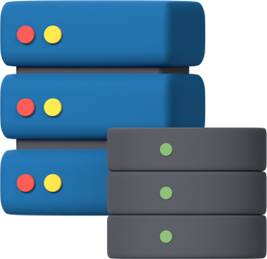





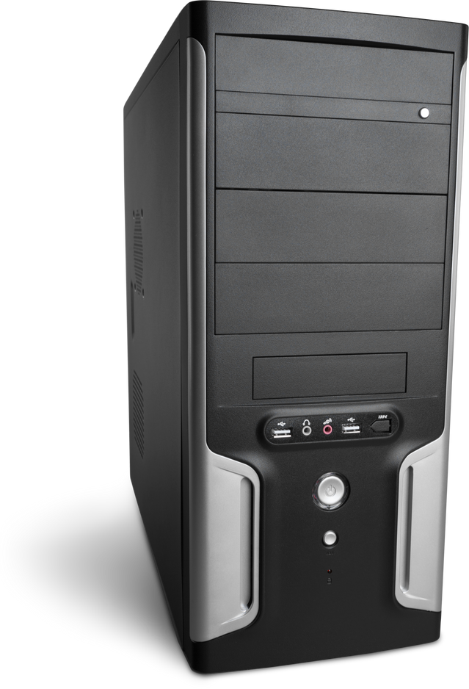
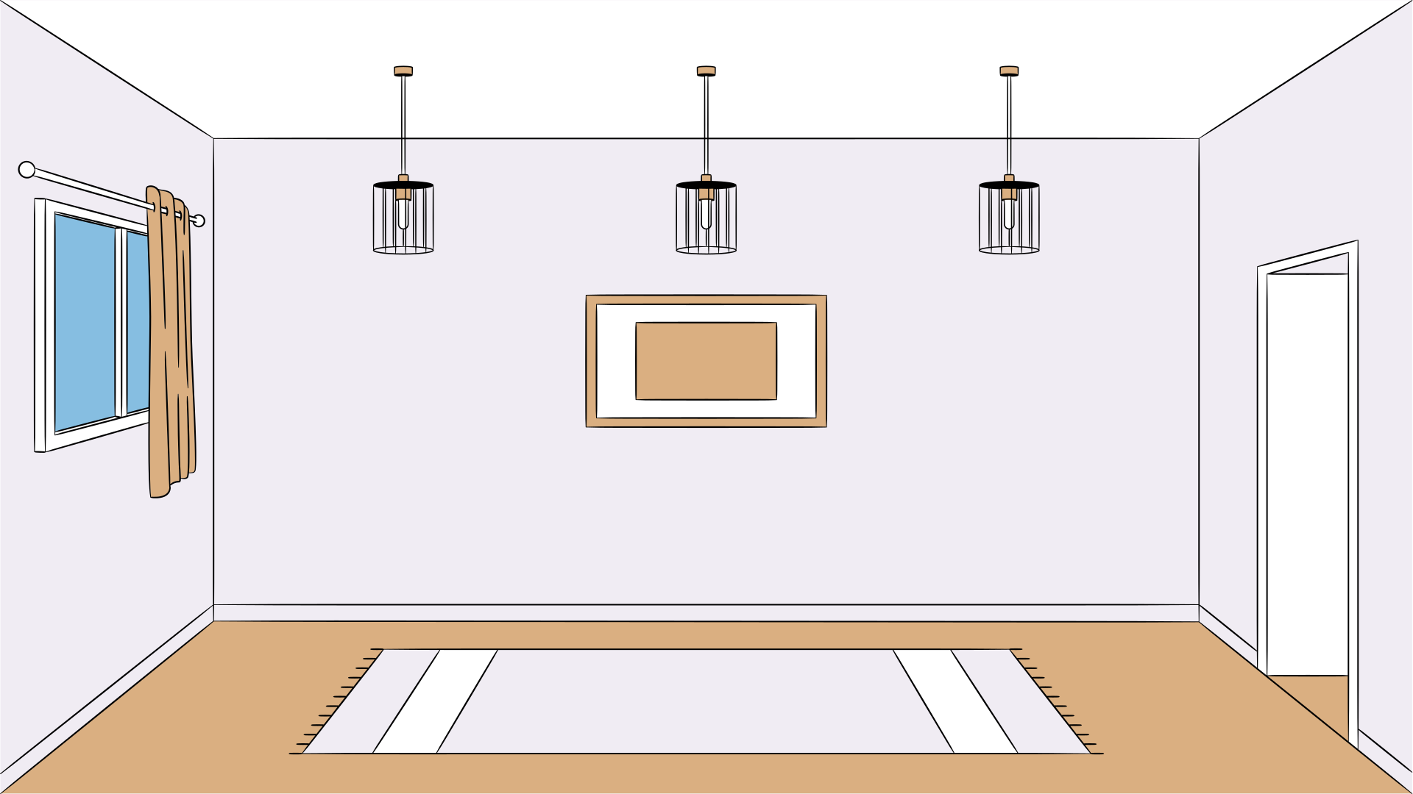




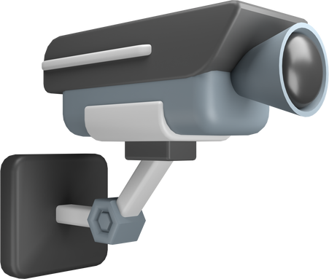
SYSTEM ARCHITECTURE
API
Cloud
API
Alert Notification
Server
Data Store
PC1
PC2
PC3
Camera 2
Camera 1
Camera 2
Bed Room
Lounge

Slide 13
Implemented Modules
Module | Status
OAuth Server
Activity Recognition
Activity Charts
Communication Protocol (RabbitMQ)
Forecasting Module
Payment Gateway
Mobile App

Slide 14
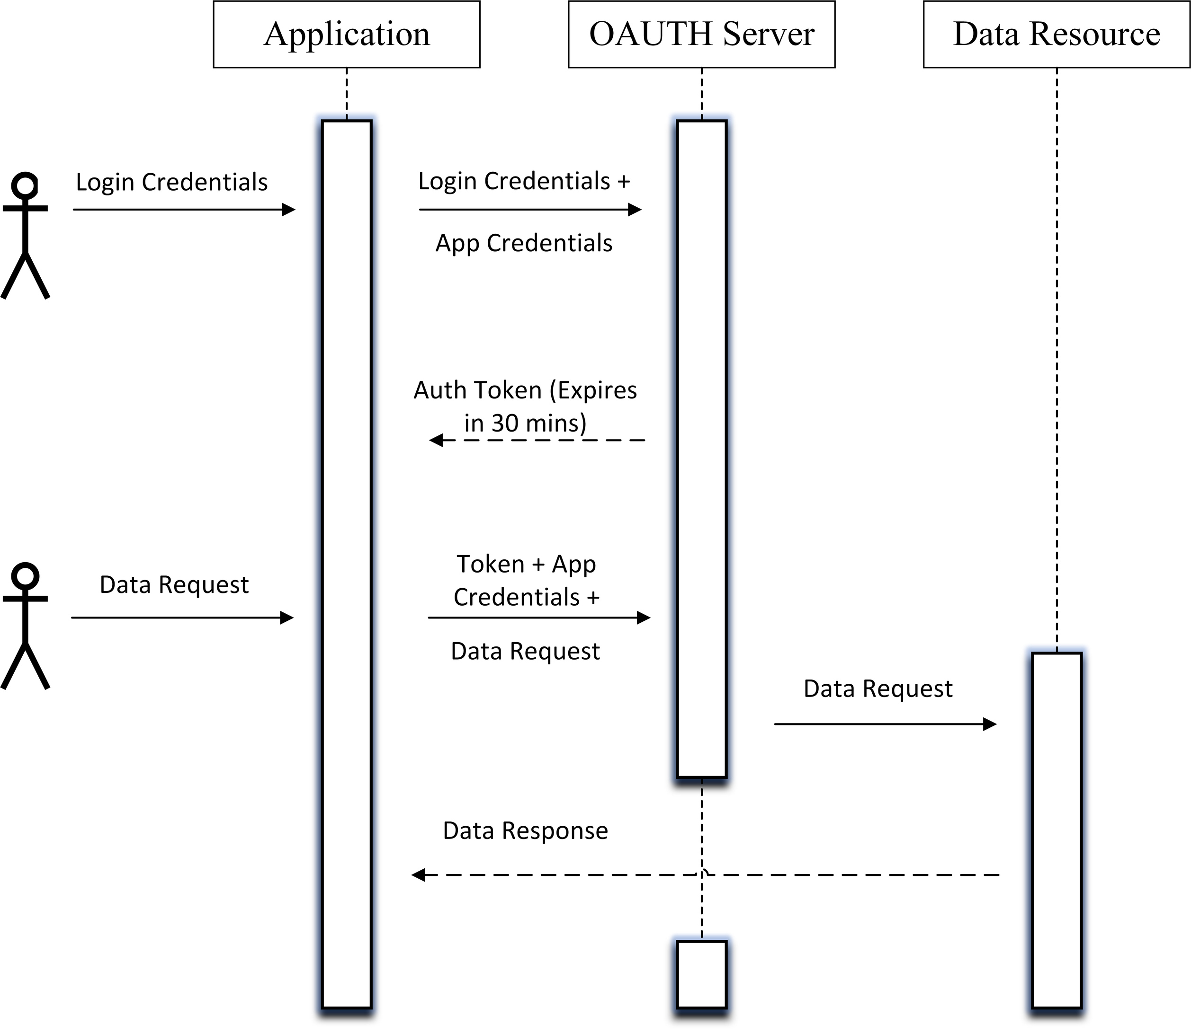
OAuth Server
Prioritizes security through encryption, token management, and HTTPS enforcement.
7
Notes:
Constant monitoring of elderly epileptic patients burdens caretakers and intrudes upon patients' privacy.(burden removal on caretaker)
The exponential rise in elderly epilepsy underscores the demand for enhanced medical support and lifestyle adjustments.
Efficient and economical monitoring solutions are imperative to detect and forecast seizures, alle vialing strain on caregivers.
Implementing such solutions promises to relieve pressure on the nursing sector, preserve patient privacy, and stimulate economic growth in healthcare.

Slide 15
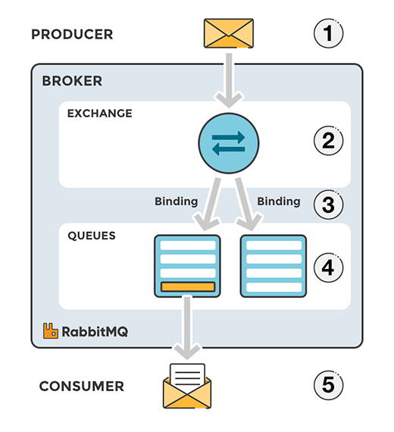
RabbitMQ
Serves as a mediator
Advanced Message Queuing Protocol (AMQP)
Decoupling of system
Scalable System
7
Notes:
Constant monitoring of elderly epileptic patients burdens caretakers and intrudes upon patients' privacy.(burden removal on caretaker)
The exponential rise in elderly epilepsy underscores the demand for enhanced medical support and lifestyle adjustments.
Efficient and economical monitoring solutions are imperative to detect and forecast seizures, alle vialing strain on caregivers.
Implementing such solutions promises to relieve pressure on the nursing sector, preserve patient privacy, and stimulate economic growth in healthcare.

Slide 16
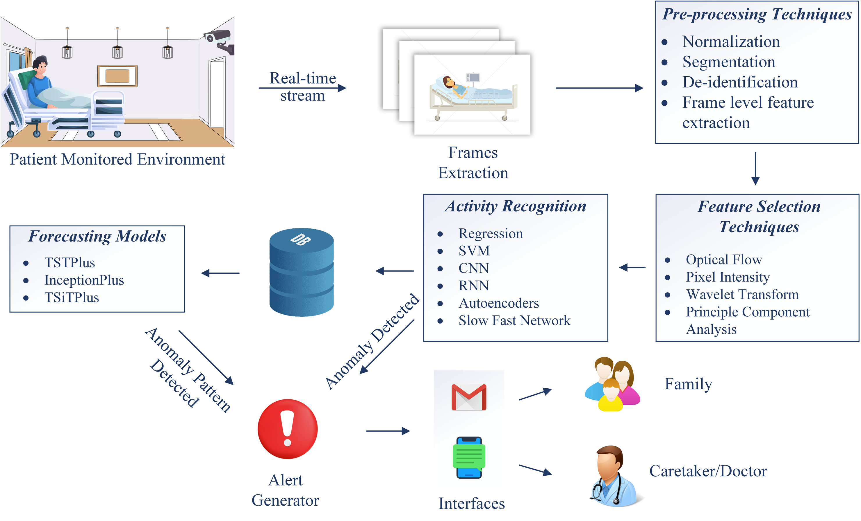
General Methodology

Slide 17

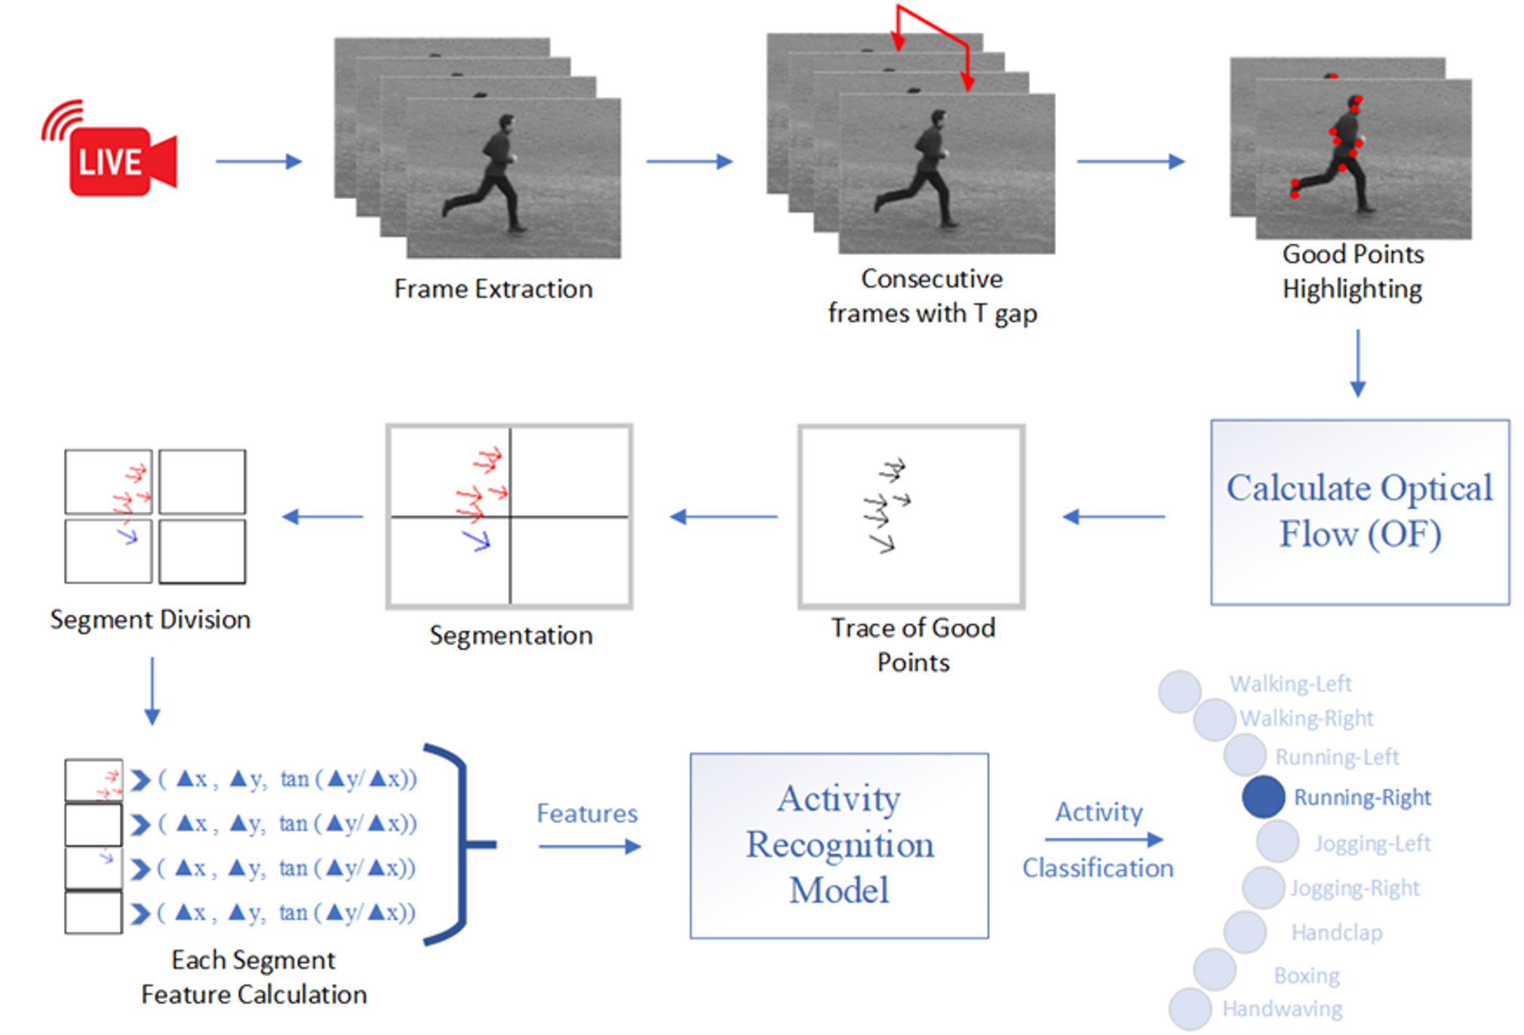
Activity Recognition Using Optical Flow
14

Slide 18

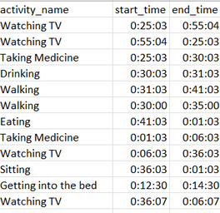
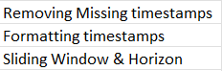
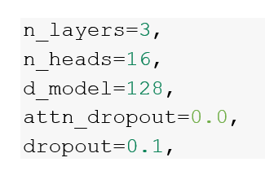
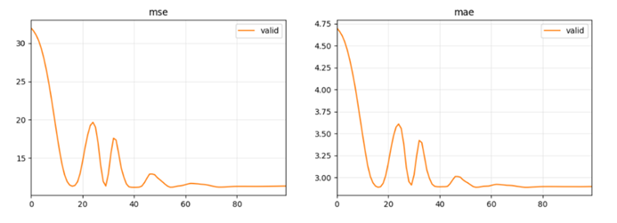
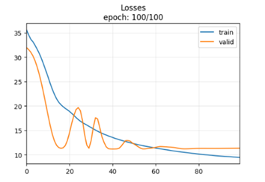
Forecasting Using tsai
Data (Activtity Logs)
Pre-Processing
TSTPlus(Model)
Hyperparameters
Forecasting
Activity
Results
14

Slide 19
THANKS!
17

Slide 20

IOT-VISION ENABLED ASSISTANCE FOR EPILEPTIC PATIENTS

